Slide 1

Game Technology
Lecture 1 – 17.10.2014
Dipl-Inf. Robert Konrad
Dr.-Ing. Florian Mehm

Slide 2
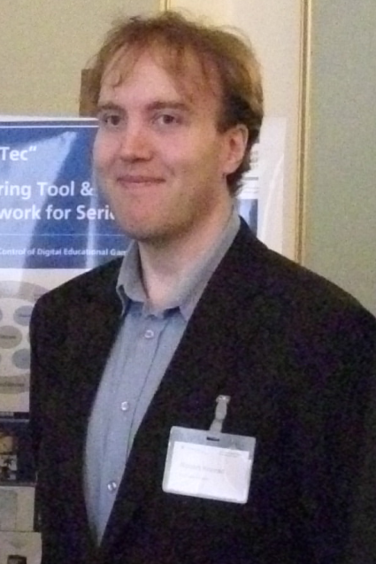
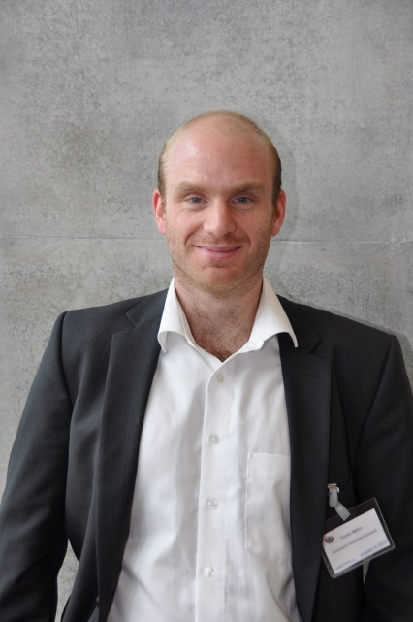
Welcome!
Introduction
Robert Konrad
Favourite Game: Super Hexagon
Studied Computer Science in Darmstadt
No PhD ☹
Open source game tech developer
Florian Mehm
Favourite Game: The Longest Journey
Studied Computer Science in Darmstadt
PhD at Multimedia Communications Lab, Serious Games
Focus on authoring tools for games

Slide 3
Organization
Lecture (V2, weekly)
Friday, 9:50 to 11:30, S103/9
Lecturers: Robert Konrad, Florian Mehm
Exercise (Ü2, weekly)
Friday, after lecture, 11:40 – 13:20, S103/100
Theory and implemention (game programming)
Each week 1 exercise, 1 week to work on the task
Exam
90 Minutes
Date and location TBD

Slide 4
Organization
Sign up with TuCan
Consultation hour during the exercise
In case no one shows up for the exercise, we will not wait the whole time slot
Current news
Website@KOM: http://www.kom.tu-darmstadt.de/teaching/current-courses/sg-lecture0/overview1/
Wiki, including the lecture slides and script: wiki.ktxsoftware.com
Fachschafts-Forum: https://www.fachschaft.informatik.tu-darmstadt.de/forum/viewforum.php?f=557

Slide 5
Exercises
Each week a new exercise sheet
Practical (programming) tasks
Theoretical tasks
Exercise slot on Fridays
Discuss the previous exercise
Show interesting solutions
Exercises will have due dates
These dates are non-negotiable
Bonus Points
>50%: 0.3; >70%: 0.7; >90%: 1.0
The exam has to be passed without the bonus points – bonus is added only after the exam has been passed regularly

Slide 6
Exercises
Group Exercises
Allowed to complete exercises in groups up to 3 members
Turn in exercises via FTP until Friday of the next week before the exercise starts (11:40)
Group Formation
Choose your own name
Send group information to game-technology@kom.tu-darmstadt.de, including:
Group name
Names of all members
Mail adresses of all members
Until Tuesday, 21.10.2014, 23:59
Turning in Solutions
Theory: As PDF, scan written answers or work digitally
Source Code: See today‘s C++ lecture…

Slide 7
Preliminary timetable
Lecture No. | Date | Topic
1 | 17.10.2014 | Basic Input & Output
2 | 24.10.2014 | Timing & Basic Game Mechanics
3 | 31.10.2014 | Software Rendering 1
4 | 07.11.2014 | Software Rendering 2
5 | 14.11.2014 | Basic Hardware Rendering
6 | 21.11.2014 | Animations
7 | 28.11.2014 | Physically-based Rendering
8 | 05.12.2014 | Physics 1
9 | 12.12.2014 | Physics 2
10 | 19.12.2014 | Scripting
11 | 16.01.2015 | Compression & Streaming
12 | 23.01.2015 | Multiplayer
13 | 30.01.2015 | Audio
14 | 06.02.2015 | Procedural Content Generation
15 | 13.02.2015 | AI

Slide 8
Warning
This class will require programming
C++
GLSL
(Lua)
This class will be hands-on
Exercises will be required to understand the topics
Work sheets will include questions about practical problems and implementation issues
This class will cover a lot of information
The whole game engine stack
With many detailed looks into the implementations

Slide 9

Relation to other lectures
Serious Games
Lecture
Seminar
(Projekt)Praktikum
Urban Health Games
FIF Schwerpunkt Serious Games
http://www.fif.tu-darmstadt.de/fif_topics_structure/fif_serious_games_structure_ref/index.de.jsp
Computer Graphics

Slide 10



Questions & Contact
RK
game-technology@kom.tu-darmstadt.de

Slide 11
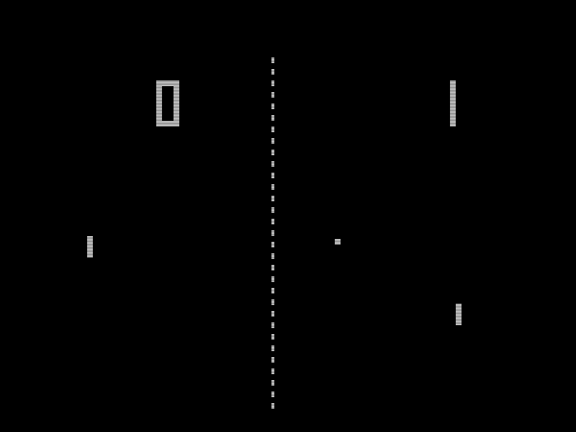
Video Games

Slide 12
Focus on Performance
Manual memory management
Shader programming
…
Separate lecture part
~1 hour abstract theory
~30 minutes programming

Slide 13
Pseudo-realistic realtime simulations

Slide 14
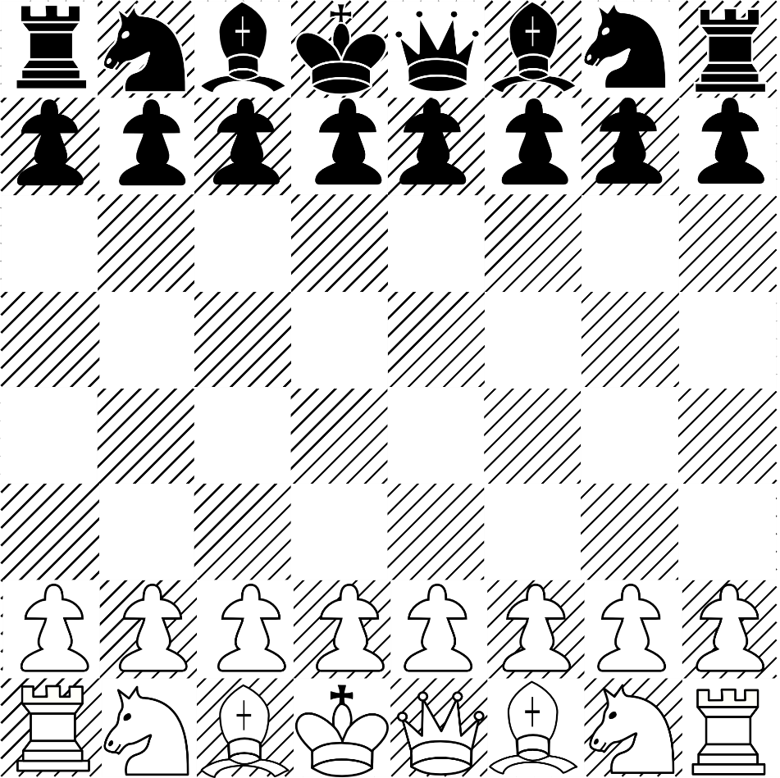
Pseudo-realistic realtime simulations
No chess
Focus on fast/realtime apps
Running in a game loop

Slide 15
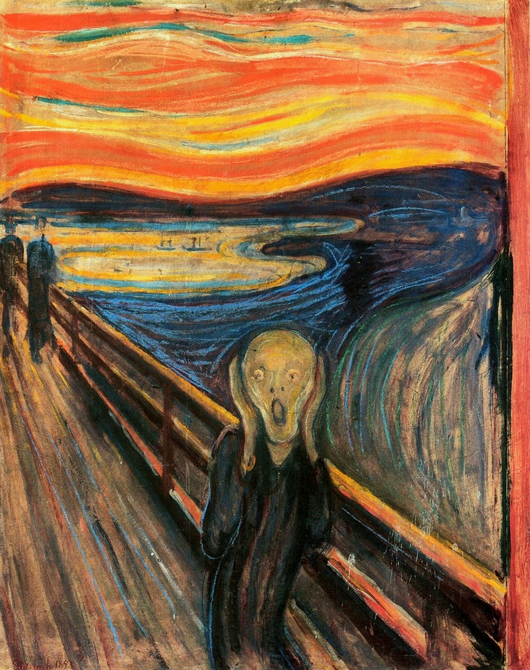
Pseudo-realistic realtime simulations
No artsy games
But understanding how to make realistic games also helps with non-realistic games

Slide 16
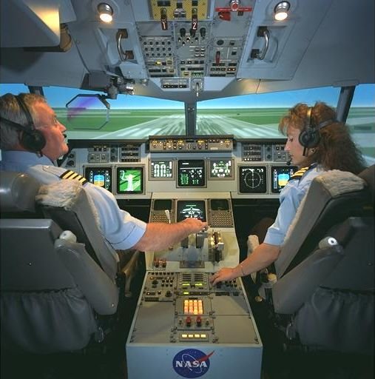
Pseudo-realistic realtime simulations
No flight simulators for Lufthansa
Actual realism not necessary
And probably too slow
Requires knowledge of human perception

Slide 17

Human-Machine data transfer
Human
Output
Pushing
Talking
Moving
Input
Staggering amounts of data
Machine
Output
Monitor
Speakers
Input
Buttons

Slide 18
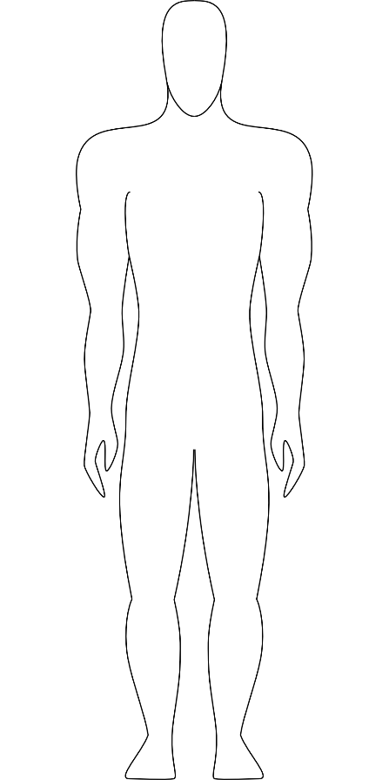
Humans
Five senses
Sight
Hearing
Touch
Smell
Taste

Slide 19
Humans
Many senses
External
Sight
Hearing
Touch
Smell
Taste
Acceleration
Temperature
Internal
Kinesthetic
Pain
…

Slide 20

Eyes and Ears
Most dominant sensors
Measure different kinds of waves

Slide 21
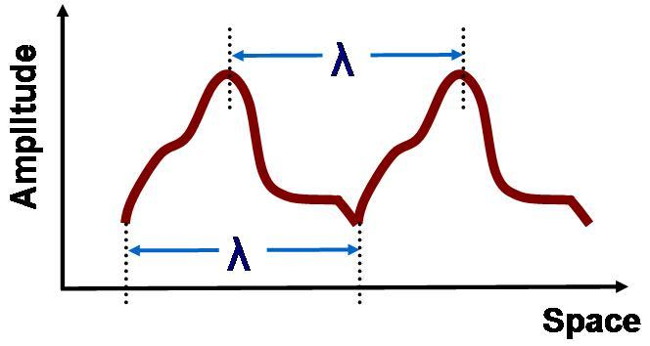
Waves
Wave Direction
Oscillation Direction (for transverse waves)
Amplitude
Speed (often constant)
Wavelength
Waveform
Frequency = Speed / Wavelength

Slide 22
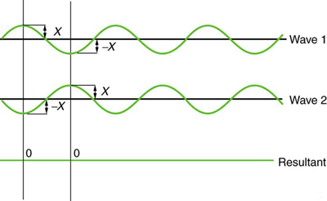
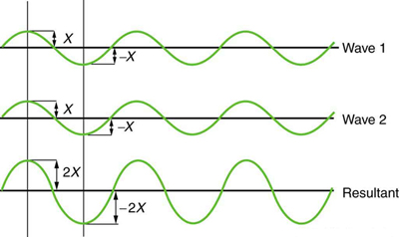
Wave Interaction
Superposition
Notes:
Pictures from https://www.boundless.com/physics/textbooks/boundless-physics-textbook/sound-16/interactions-with-sound-waves-131/interference-466-6692/

Slide 23
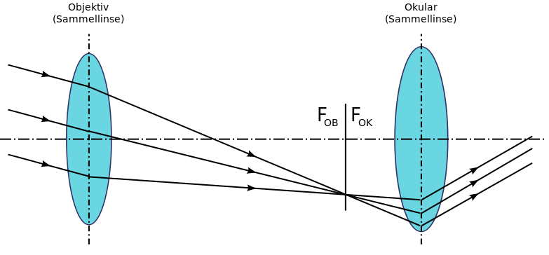
Light Waves
Electromagnetic waves
Transverse waves
Direction of oscillation orthogonal to wave direction
Very fast
Usually discussed using simplified models

Slide 24
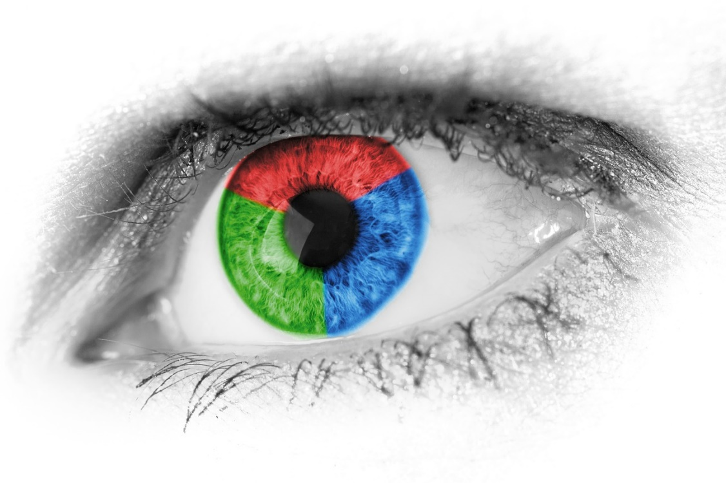
Optical Sensors
Two units
Surround view or 3D view depending on arrangement

Slide 25
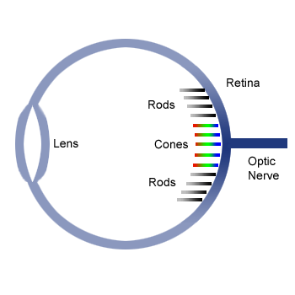
The eye
The lens focuses light on the retina
Rods measure light intensity/energy (wave amplitude and frequency)
Cones only react to specific wavelengths
Three different kinds
Red, green and blue

Slide 26
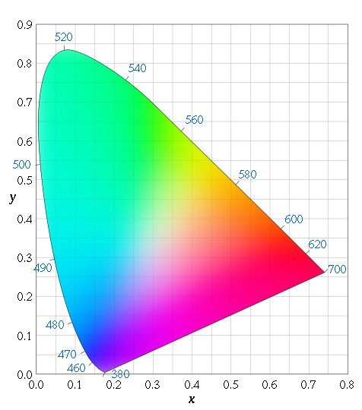
Red, green and blue
Brain interpolates colors
Brain sees magenta when interpolation fails
Same amounts of blue and red but no green
Colors are not just wavelengths
2D value

Slide 27
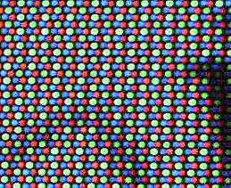
Monitors
Exact counterpart to human eye
Red, green and blue emitters
No physically accurate picture reproduction

Slide 28
Computer -> Monitor
Designated memory area which is transferred to the monitor
The framebuffer
Structurally equivalent to the pixel structure
1 red byte, 1 green byte, 1 blue byte, …

Slide 29
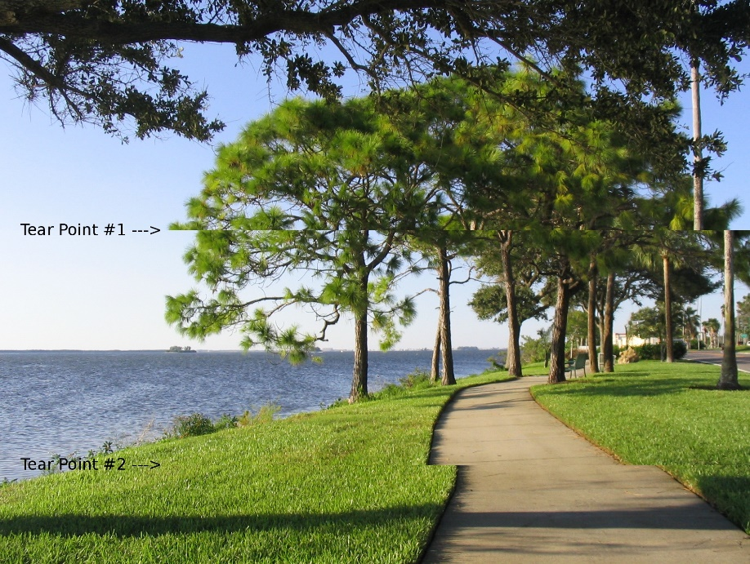
Vertical Sync
Monitors typically operate at framerates of 60 Hz
Picture is transfered during a designated timeslot (vblank)
Game has to wait for that timeslot after image calculations are done, or else…

Slide 30
Double Buffering
Render image to off-screen buffer
Wait for vblank signal
Set buffer as monitor input array
Switch to previous buffer
Repeat
Triple buffering
Additional buffer to avoid waiting time
The new thing - G-Sync (nVidia), Freesync (AMD)
Dynamic monitor framerate
Transfer image when finished

Slide 31
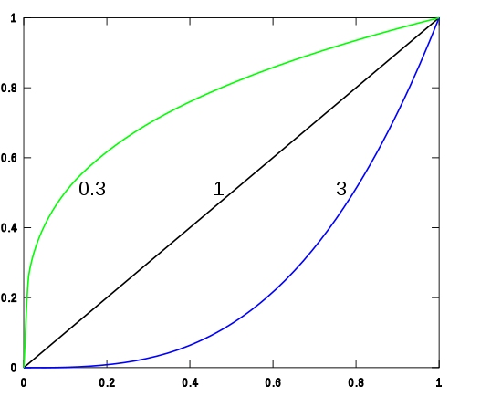
Gamma
Monitors do not emit 50% light intensity for a 50% light value
Work according to a gamma function
Monitor color space is not ideal for lighting calculations

Slide 32

Sound Waves
Air compression
Longitudinal Waves
~343 m/s

Slide 33

Sound sensors
Also two units
Infer direction by measuring time differences
Measures actual wave forms

Slide 34

Loudspeakers
Construct actual sound waves
Physically accurate reproduction of original waves

Slide 35
Computer -> Speaker
Small ring buffer
Discretely sampled waveform
Pointer to last sample written
Pointer to next sample to read

Slide 36
Sound Mixing
Superpositioning
Adding waves
Again physically accurate
Actual danger of superposition effects
Avoid mixing identical sounds

Slide 37
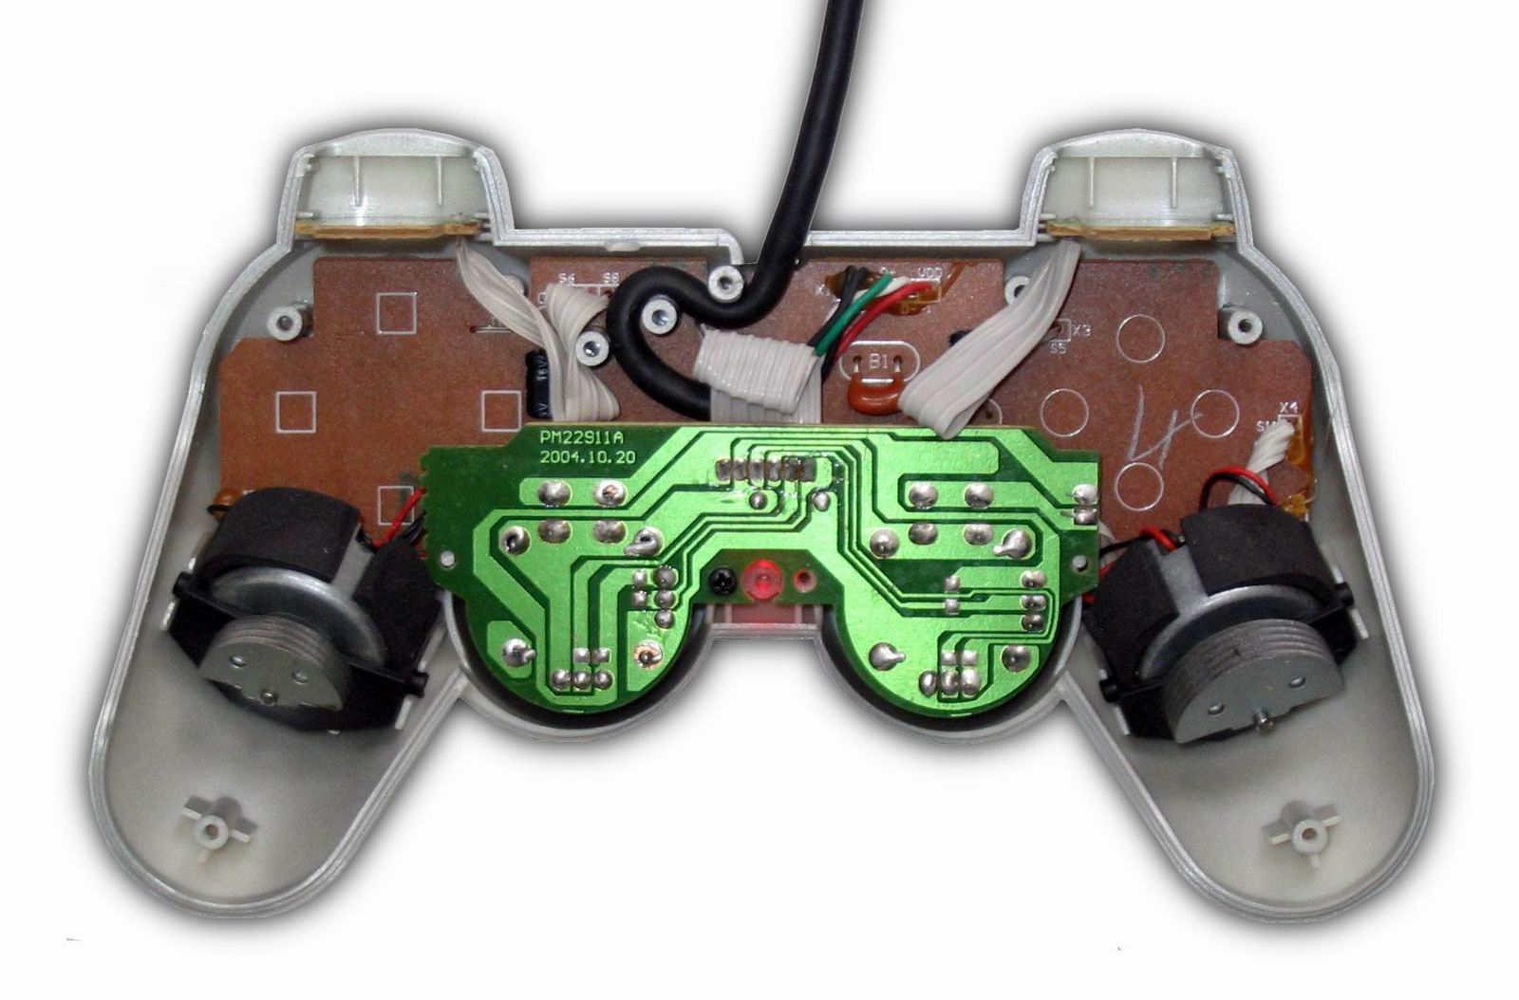
Rumble / Force Feedback
Very restricted „touch“ output

Slide 38
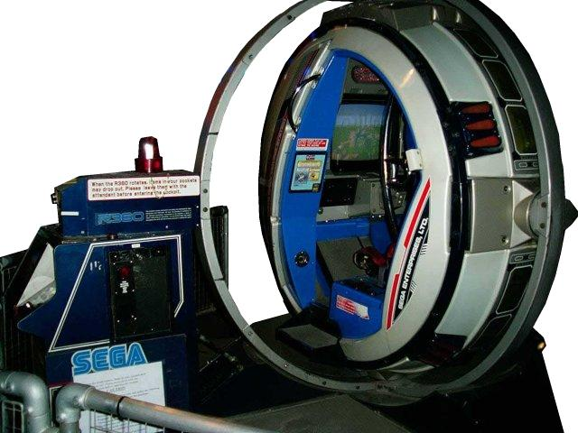
Acceleration output
Sega R-360
Notes:
Image from http://www.arcade-museum.com/

Slide 39
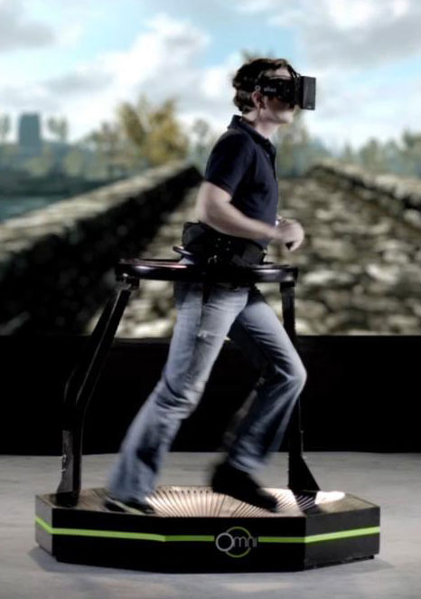
Kinesthetic
Virtuix Omni

Slide 40
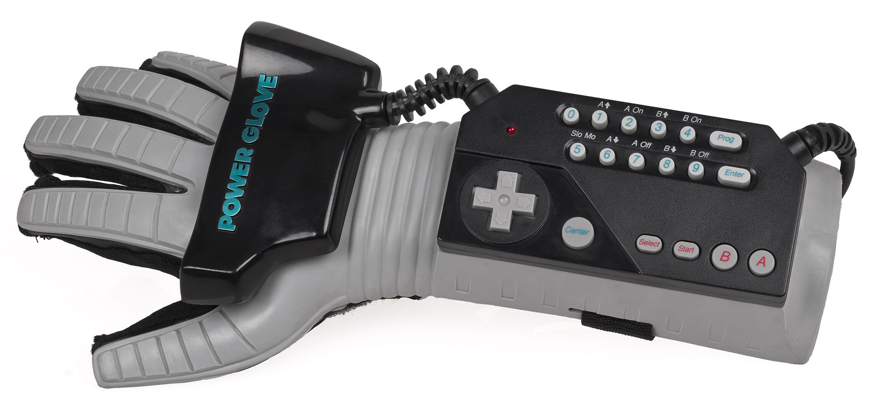
Computer input
Mouse, Keyboard, Gamepad, …
Mostly trivial
Important to reduce input lag
Minimize time from input to output
Triple buffering harmful

Slide 41
Complex computer input
Input inaccuracies
Compensate by being overly optimistic
https://www.youtube.com/watch?v=KWbLOFGSEDo

Slide 42
C/C++
Open standards, not bound to a company
Available almost anywhere
Even in the browser (Emscripten)

Slide 43
C
Portable assembler
Developed for/with UNIX
From 1969

Slide 44
C++
Adds higher level concepts to C
No performance regressions
Originally „C with classes“
From 1979

Slide 45
Classes in C++
class Foo {
public:
Foo() {
x = 2;
}
private:
int x;
};

Slide 46
Free functions
int main(int argc, char** argv) {
return 0;
}
Main entry point
But not on every system
* is a pointer
A memory address
char* is used for strings
char** - multiple strings

Slide 47
Header files
Using multiple source files is complicated
Compiler compiles single cpp file to object file
Files can #include other files in a preprocess
Use separate, minimal header files for #include
A separate linker application links multiple object files
No standard to tell the linker what to do
Primary reason that compiling C/C++ is slow

Slide 48
Foo.h
class Foo {
public:
Foo();
private:
int x;
};

Slide 49
Foo.cpp
#include “Foo.h”
Foo::Foo() {
x = 2;
}

Slide 50
C++ in 20XX
Very big language
Complex features
Templates (similar to Java‘s generics) are turing complete
Contains fancy library
Automates memory management somewhat
std::string, std::vector, …
boost Library
Widely used
Big, std style library

Slide 51
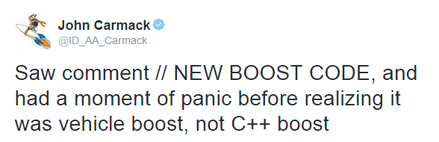
C/C++ in Games
Typically C with just a few C++ features
Avoid templates
Very hard to debug
Avoid exceptions
Can have performance impact
Can introduce resource leaks
Avoid C++ standard library
Different implementations
Unpredictable allocations

Slide 52
Hardware Access
Files
That‘s it
No support for
Special directories
Memory mapped files
…

Slide 53
OpenGL
Standard API for Graphics Hardware
Many different versions
Not on consoles
Questionable support by Apple and Microsoft

Slide 54
GPU Programming Languages
GLSL
Part of OpenGL
HLSL
Microsoft (Direct3D and Xbox)
Sony (all PlayStations)
Metal
Apple

Slide 55
Audio, Keyboard
Practically no standards
SDL can do the job

Slide 56
Kore
APIs for
Graphics
Audio
Input Devices
File Access
…
GLSL cross compiler
https://github.com/KTXSoftware/Kore
Introductions at http://wiki.ktxsoftware.com

